Slide 1
IRON LIPID & QMRI PARAMETERS

Slide 2
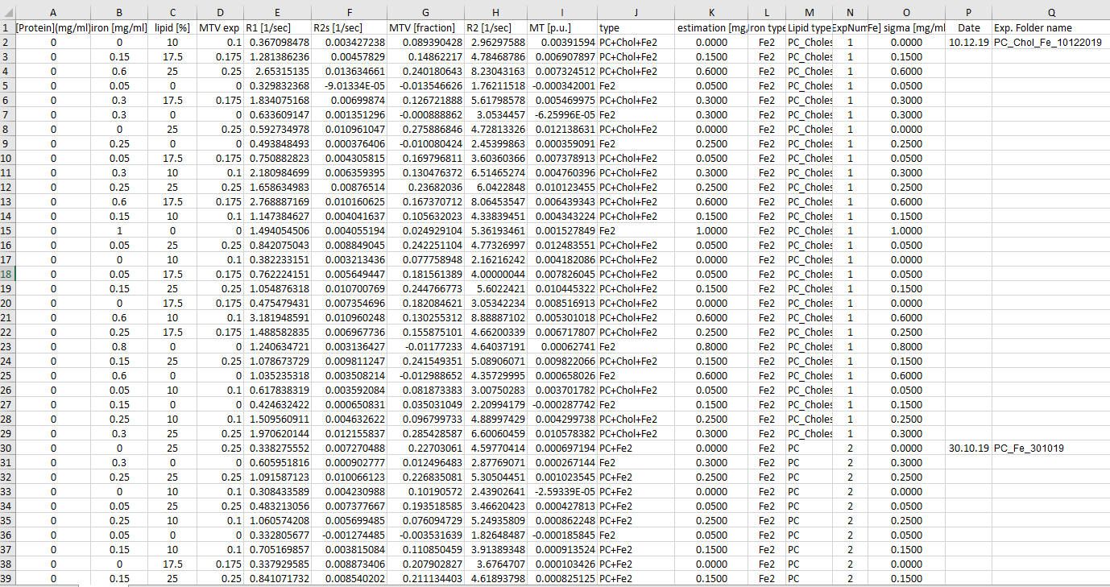
Current data
13 exp
3 iron types
3 lipid types
4 lipid conc.
Notes:
מניתוח הנתונים הורדו השורות המכילות את הליפיד – BSA+Ferritin.
ללא ניסוי 6
2

Slide 3
Summarize models
a*[Fe] + b
a*[ipid type] + b
a*[Fe] + b*[lipid type] + c
a*[Fe] + b*[ipid type] + c*[Fe]*[ipid type] + d
a*[Fe]*[ipid type] + d
a*[lipid type]*lipid_type + b*[Fe]*iron_type + c

Slide 4
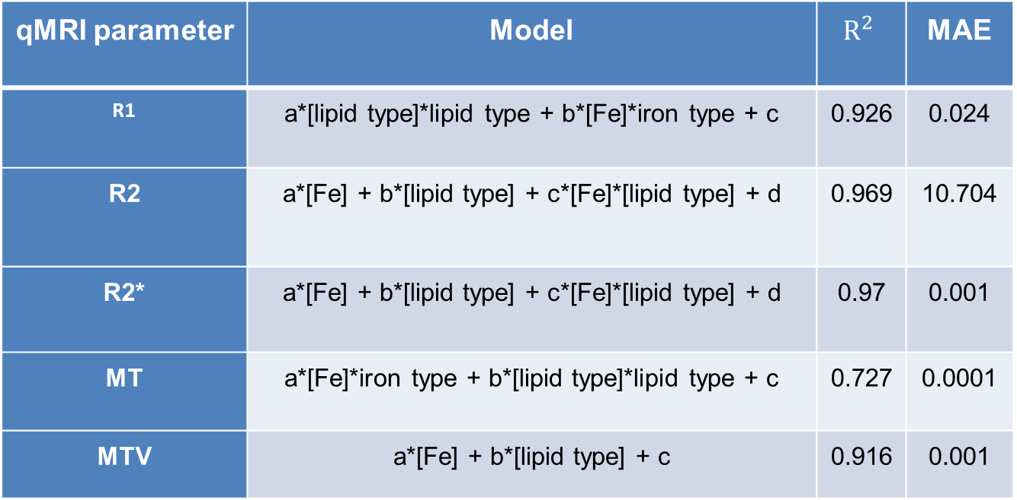
Summarize models for each parameter
qMRI parameter | Model | $$R^{2}$$ | MAE
R1 | a*[lipid type]*lipid type + b*[Fe]*iron type + c | 0.926 | 0.024
R2 | a*[Fe] + b*[lipid type] + c*[Fe]*[lipid type] + d | 0.969 | 10.704
R2* | a*[Fe] + b*[lipid type] + c*[Fe]*[lipid type] + d | 0.97 | 0.001
MT | a*[Fe]*iron type + b*[lipid type]*lipid type + c | 0.727 | 0.0001
MTV | a*[Fe] + b*[lipid type] + c | 0.916 | 0.001

Slide 5
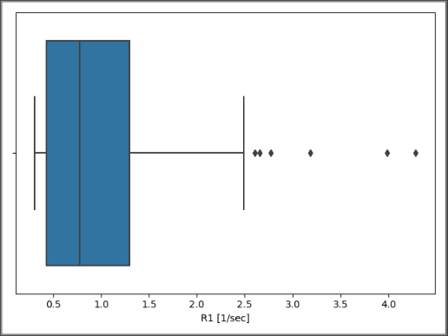
Detect outliers
To detect outliers, Z-score was calculated Z = x-μσ where μ=mean of the X; σ=Standard deviation; X= the target qMRI parameter.
Z-score values greater than or less than + 3 or − 3, respectively, are considered outliers.
After calculating the Z-score for the R1 values, values with distance a of 3 standard deviations and more from the mean, were disqualified (3 samples).
Notes:
Outliers מוגדרים כדגימות אשר רחוקות יותר משלוש סטיות תקן מהממוצע

Slide 6
Cross validation
Leave one out cross validation
The model is trained using n − 1 subsets, which, together, represent the training set. Then, the model is applied to the remaining subset, which is denoted as the validation set, and the performance is measured.
This procedure is repeated until each of the n subsets has served as validation set.
The average of the n performance measurements on the n validation sets is the cross-validated performance.

Slide 7
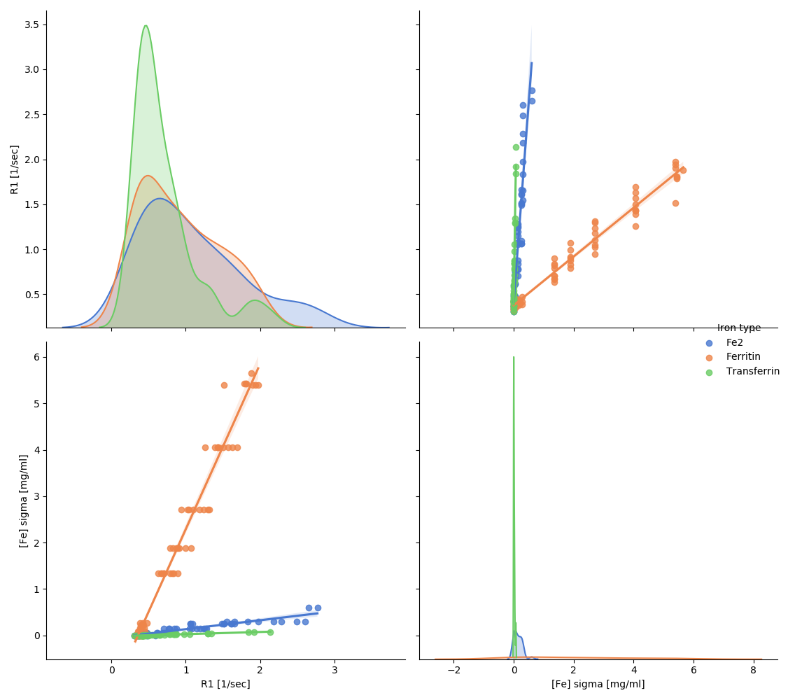
R1 & Iron relations
Examine the relation between R1 & iron
Notes:
רואים כי יש הבדלי שיפועים משמעותיים לפי סוג ברזל
7

Slide 8
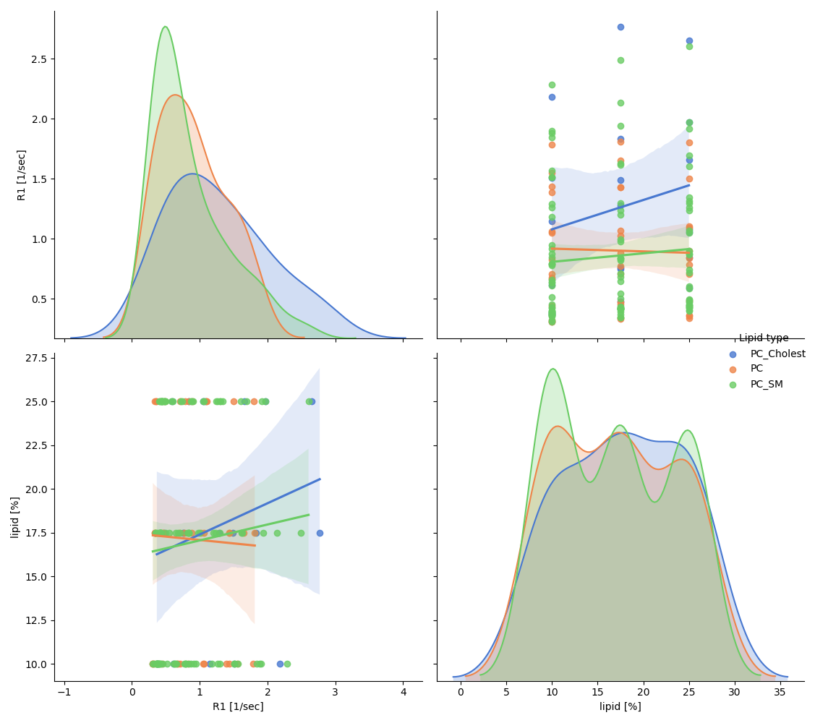
R1 & Lipid relations
Examine the relation between R1 & lipid
Notes:
8

Slide 9
Normalized MAE | R squared
0.252 | 0.223 | a*[Fe] + b
0.33 | -0.017 | a*[lipid type] + b
0.25 | 0.23 | a*[Fe] + b*[lipid type] + c
0.251 | 0.228 | a*[Fe] + b*[lipid type] + c*[Fe]*[lipid type] + d
0.258 | 0.206 | a*[Fe]*[lipid type] + d
0.024 | 0.926 | a*[lipid type]*lipid_type + b*[Fe]*iron_type + c

Slide 10
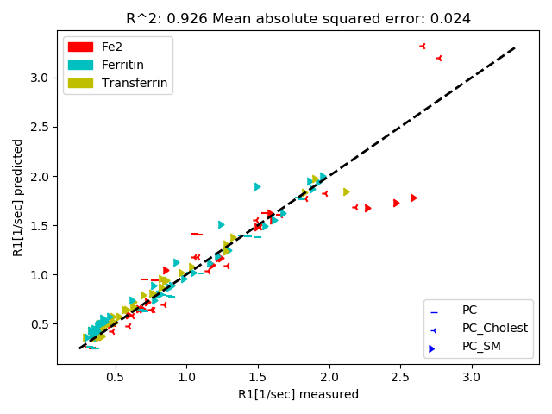
Best Model – a*[Fe]*[iron type] + b*[lipid type]*lipid type

Slide 11
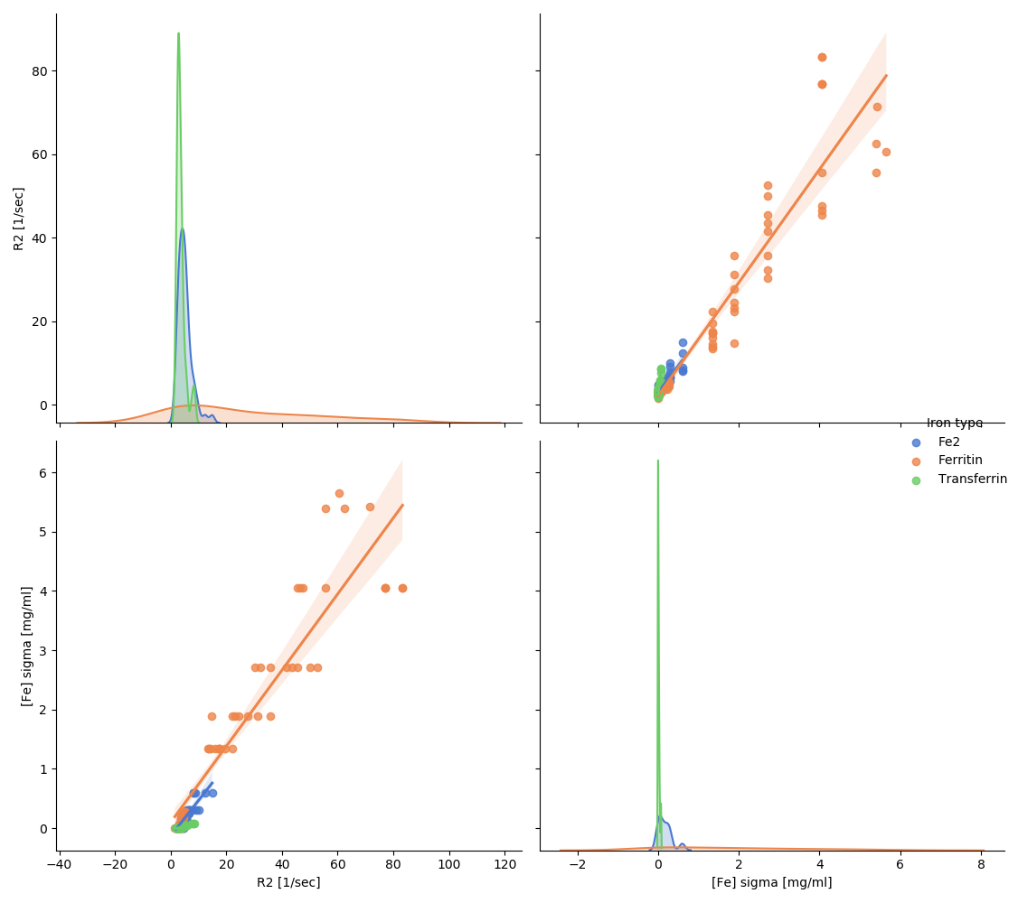
R2 & Iron relations
Examine the relation between R2 & iron
Notes:
רואים כי הקשר לינארי – אין הבדלי שיפוע משמעותיים בין ריכוזי הליפיד השונים
11

Slide 12
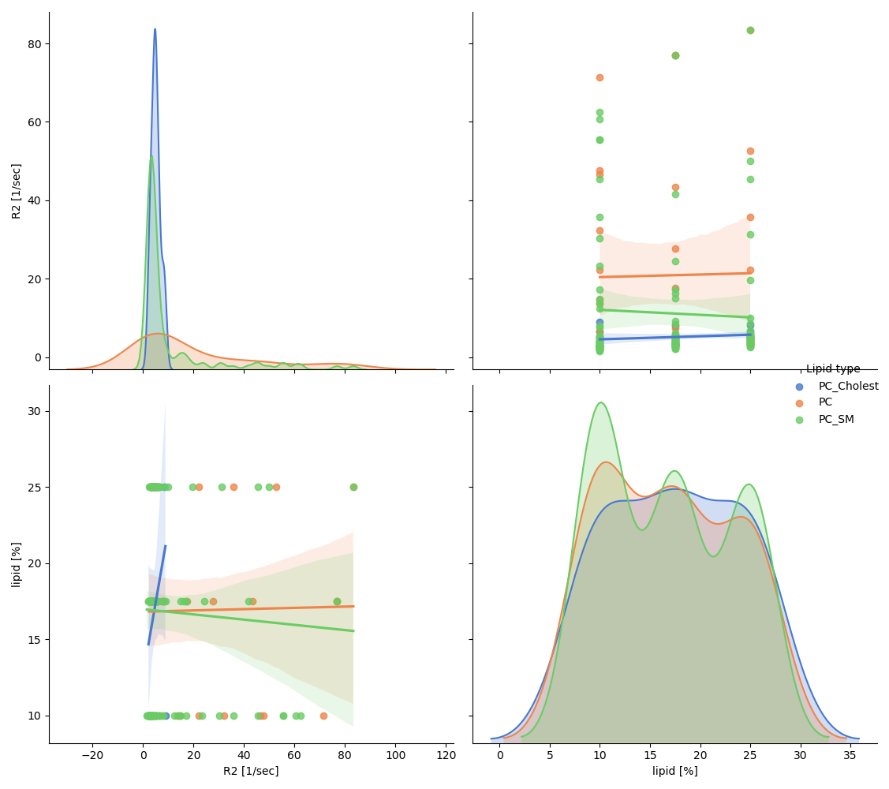
R2 & Lipid relations
Examine the relation between R2 & lipid
Notes:
רואים כי הקשר לינארי – אין הבדלי שיפוע משמעותיים בין ריכוזי הליפיד השונים
12

Slide 13
Normalized MAE | R squared
33.739 | 0.902 | a*[Fe] + b
352.825 | -0.025 | a*[lipid type] + b
29.067 | 0.916 | a*[Fe] + b*[lipid type] + c
10.704 | 0.969 | a*[Fe] + b*[lipid type] + c*[Fe]*[lipid type] + d
22.949 | 0.933 | a*[Fe]*[lipid type] + d
28.539 | 0.917 | a*[lipid type]*lipid_type + b*[Fe]*iron_type + c

Slide 14
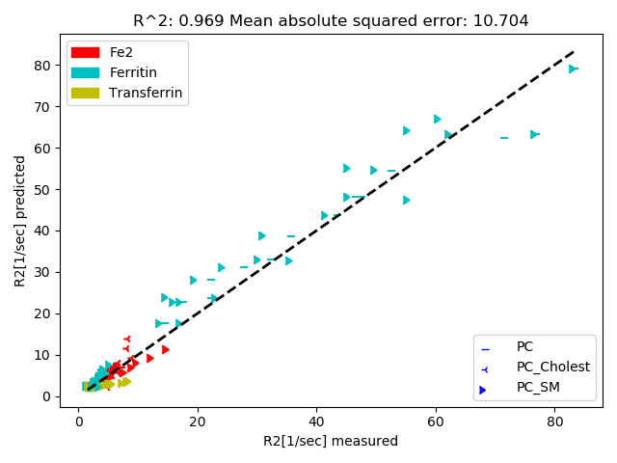
Best Model - a*[Fe] + b*[lipid type] + c*[Fe]*[lipid type] + d

Slide 15
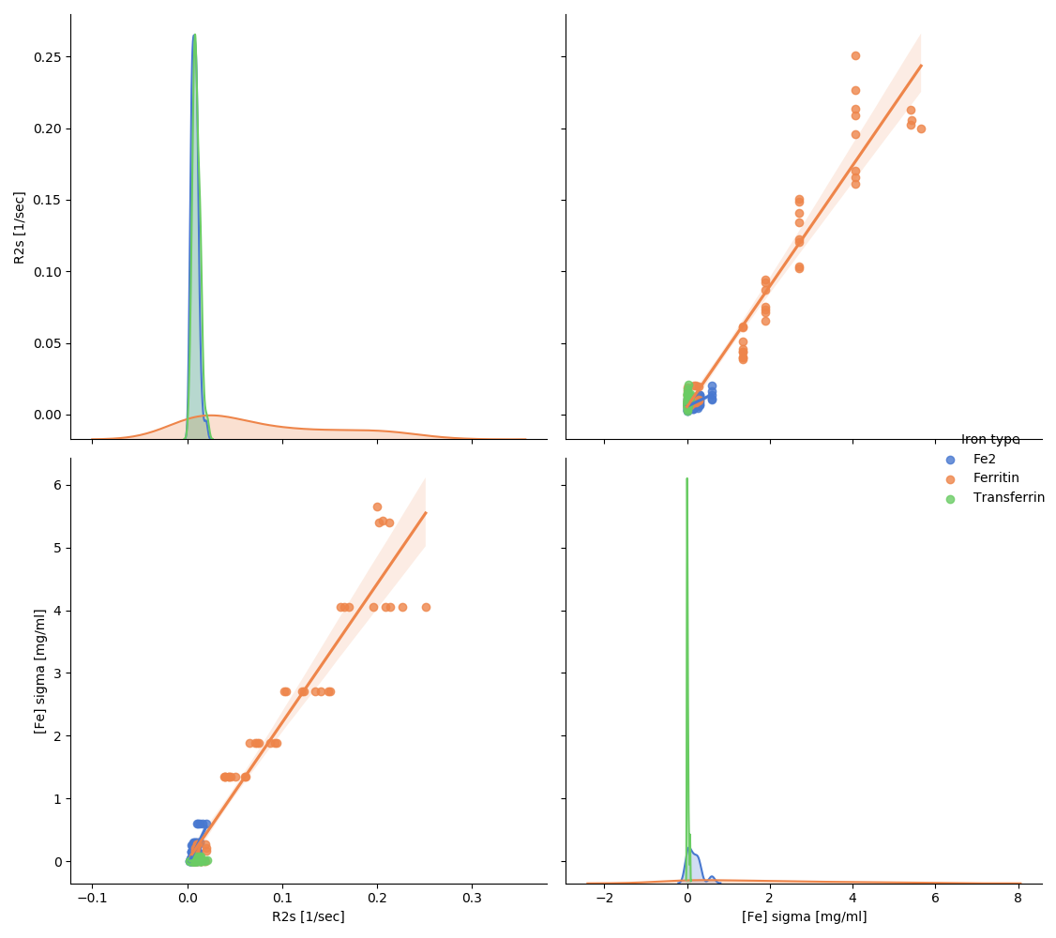
R2s & Iron relations
Examine the relation between R2s & iron
Notes:
רואים כי הקשר לינארי – אין הבדלי שיפוע משמעותיים בין ריכוזי הליפיד השונים
15

Slide 16
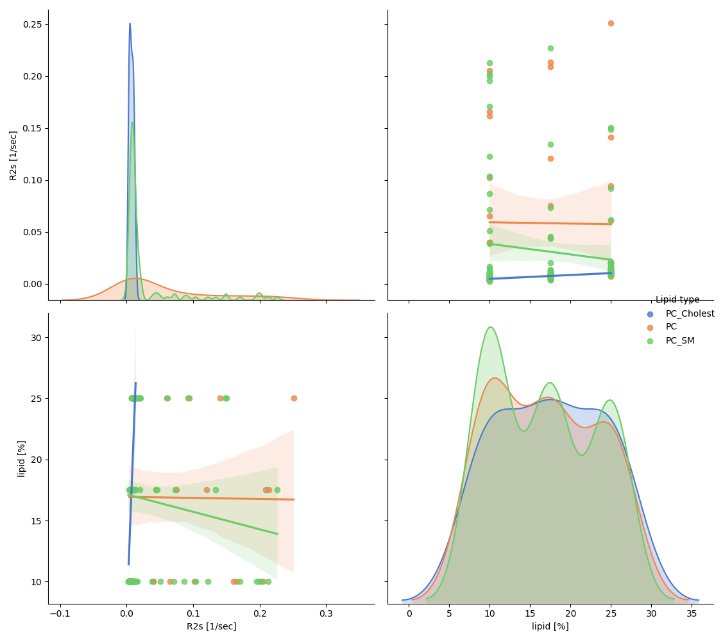
R2s & Lipid relations
Examine the relation between R2s & lipid
Notes:
רואים כי הקשר לינארי – אין הבדלי שיפוע משמעותיים בין ריכוזי הליפיד השונים
16

Slide 17
Normalized MAE | R squared
0.0 | 0.943 | a*[Fe] + b
0.003 | -0.02 | a*[lipid type] + b
0.0 | 0.951 | a*[Fe] + b*[lipid type] + c
0.0 | 0.969 | a*[Fe] + b*[lipid type] + c*[Fe]*[lipid type] + d
0.0 | 0.894 | a*[Fe]*[lipid type] + d
0.0 | 0.957 | a*[lipid type]*lipid_type + b*[Fe]*iron_type + c

Slide 18
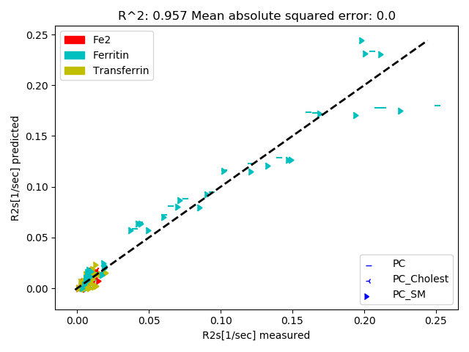
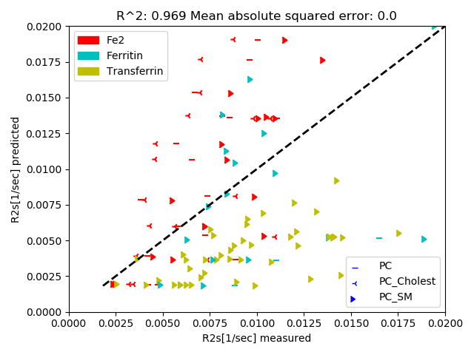
Best Model - a*[Fe] + b*[lipid type] + c*[Fe]*[lipid type] + d

Slide 19
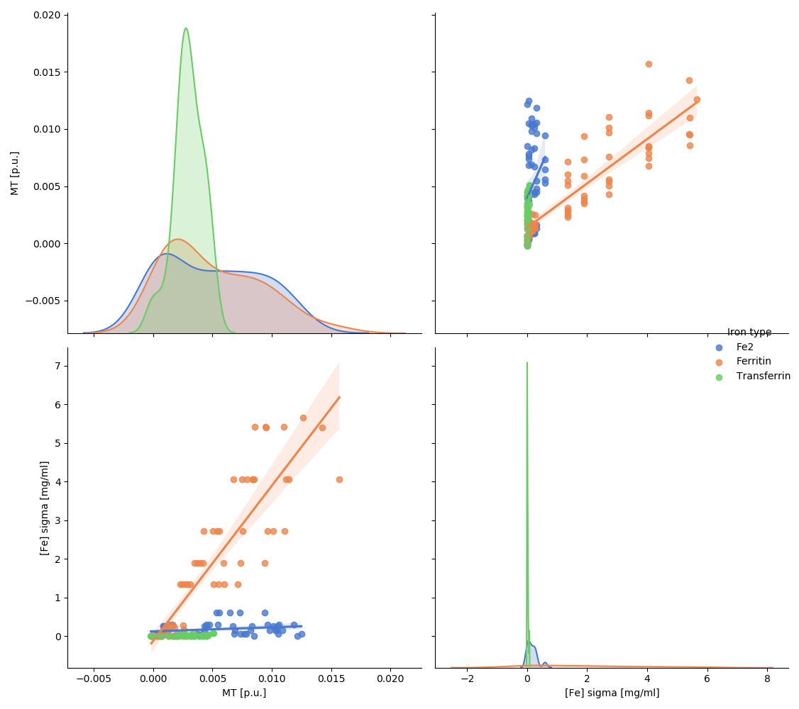
MT & Iron relations
Examine the relation between MT & iron
Notes:
19

Slide 20
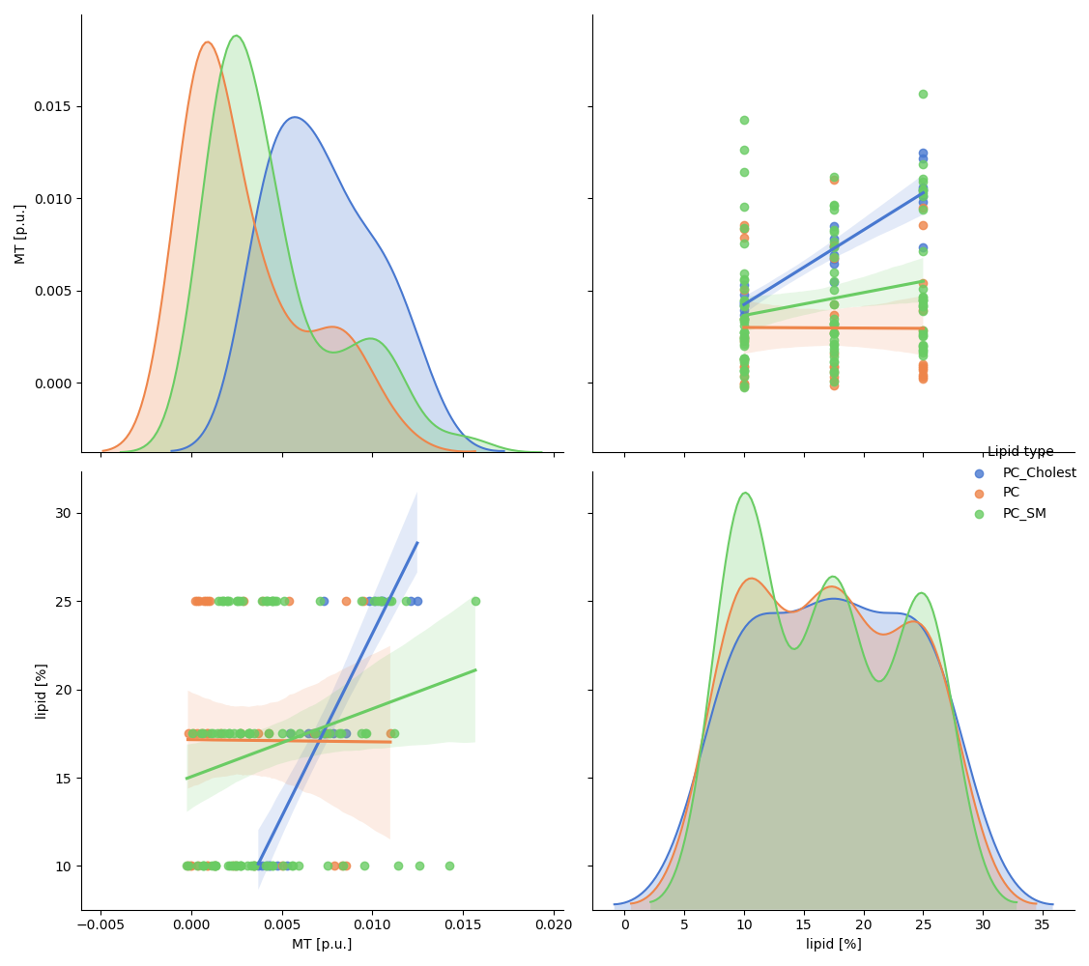
MT & Lipid relations
Examine the relation between MT & lipid
Notes:
20

Slide 21
Normalized MAE | R squared
0.0 | 0.31 | a*[Fe] + b
0.0 | -0.028 | a*[lipid type] + b
0.0 | 0.388 | a*[Fe] + b*[lipid type] + c
0.0 | 0.381 | a*[Fe] + b*[lipid type] + c*[Fe]*[lipid type] + d
0.0 | 0.289 | a*[Fe]*[lipid type] + d
0.0 | 0.727 | a*[lipid type]*lipid_type + b*[Fe]*iron_type + c

Slide 22
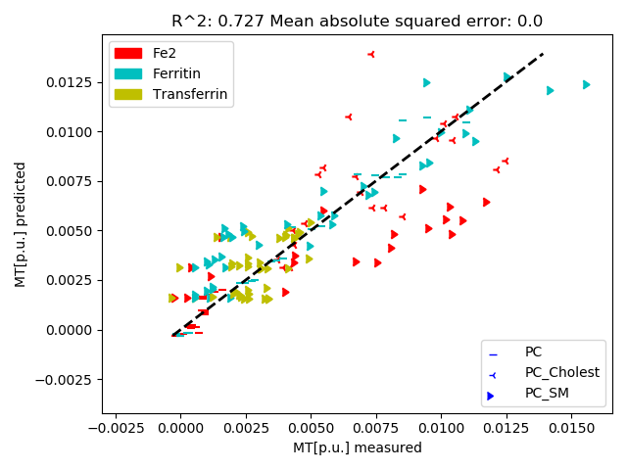
Best Model - a*[lipid] + b*[Fe] sigma + c * iron type + d

Slide 23
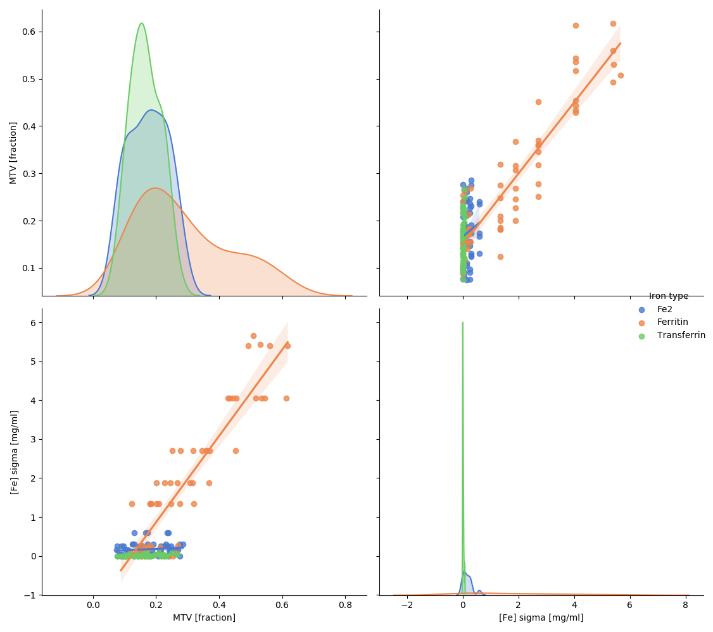
MTV & Iron relations
Examine the relation between MTV & iron
Notes:
רואים כי הקשר לינארי – אין הבדלי שיפוע משמעותיים בין ריכוזי הליפיד השונים
23

Slide 24
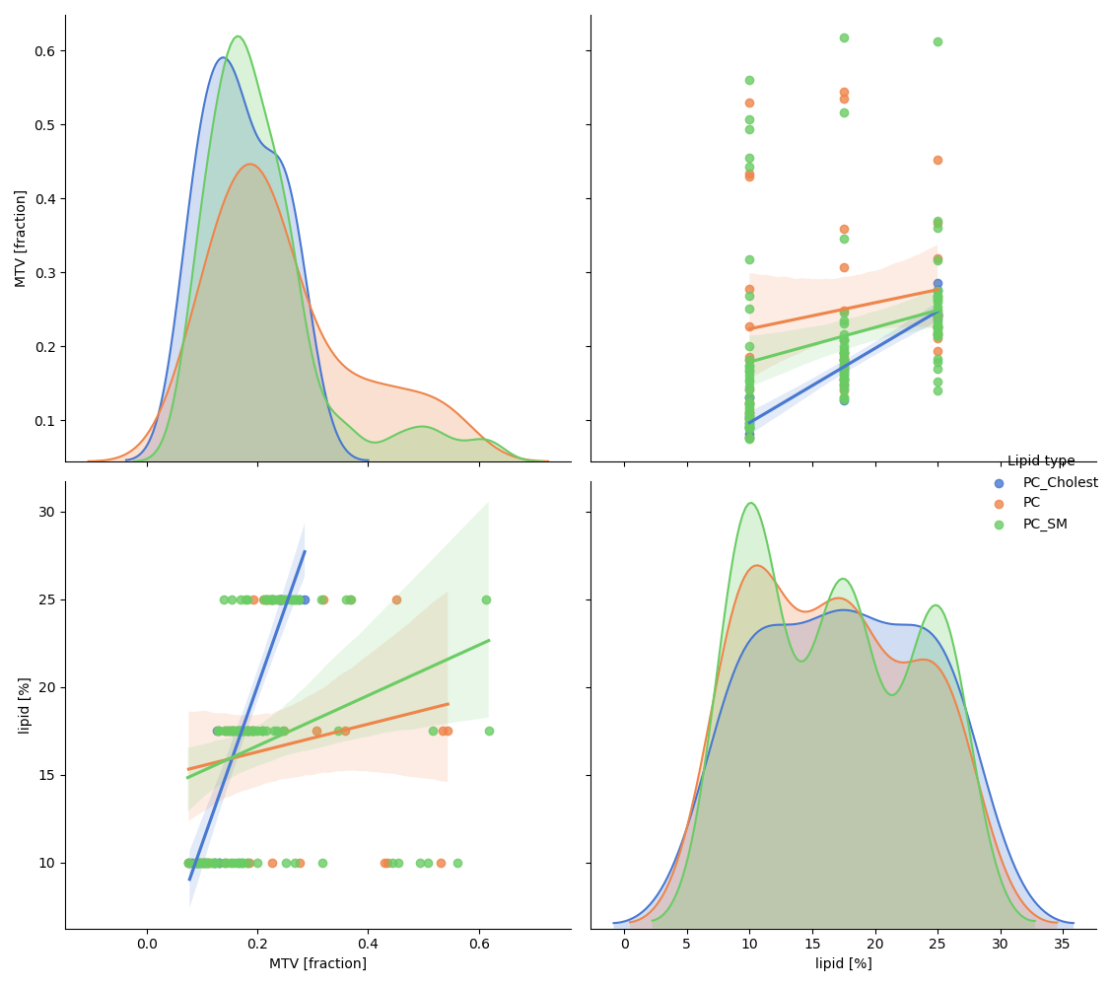
MTV & Lipid relations
Examine the relation between MTV & lipid
Notes:
רואים כי הקשר לינארי – אין הבדלי שיפוע משמעותיים בין ריכוזי הליפיד השונים
24

Slide 25
Normalized MAE | R squared
0.003 | 0.74 | a*[Fe] + b
0.012 | 0.052 | a*[lipid type] + b
0.001 | 0.916 | a*[Fe] + b*[lipid type] + c
0.001 | 0.913 | a*[Fe] + b*[lipid type] + c*[Fe]*[lipid type] + d
0.003 | 0.754 | a*[Fe]*[lipid type] + d
0.001 | 0.919 | a*[lipid type]*lipid_type + b*[Fe]*iron_type + c

Slide 26
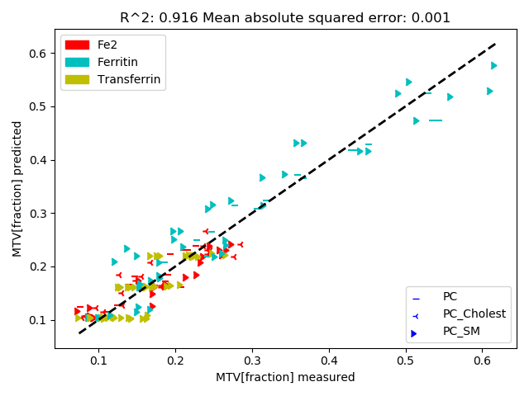
Best Model - a*[lipid type] + b*[Fe] + c

